Slide 1
Chapter 1: Introduction

Slide 2
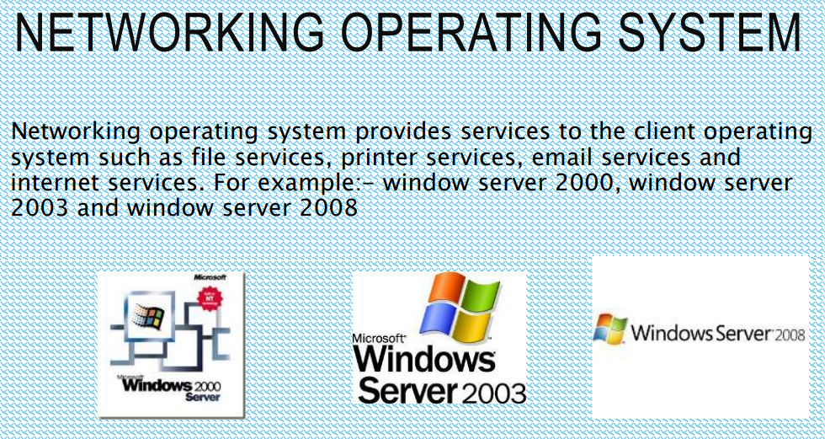

Slide 3
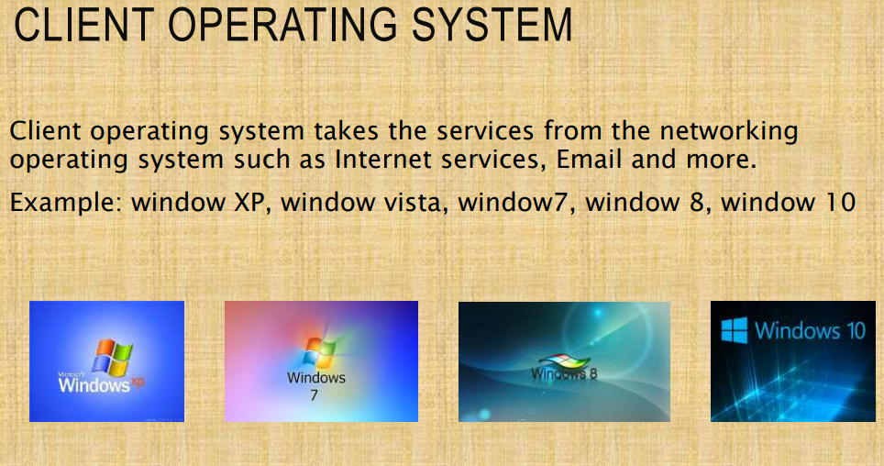

Slide 4
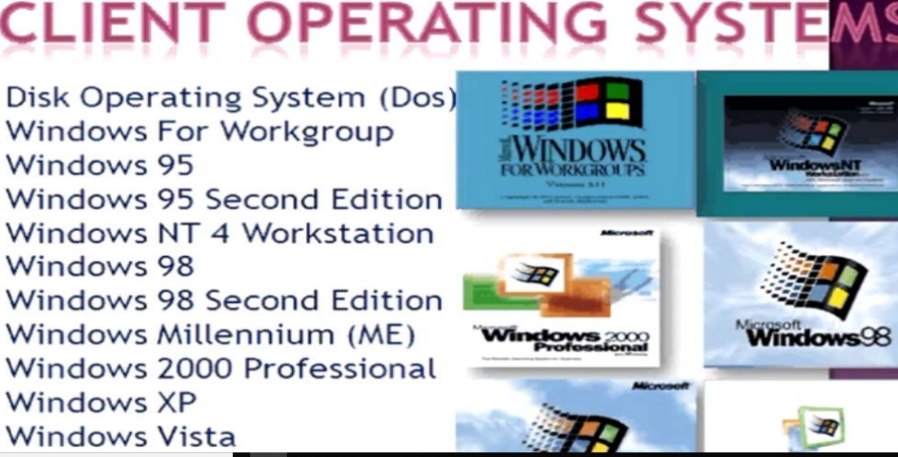

Slide 5
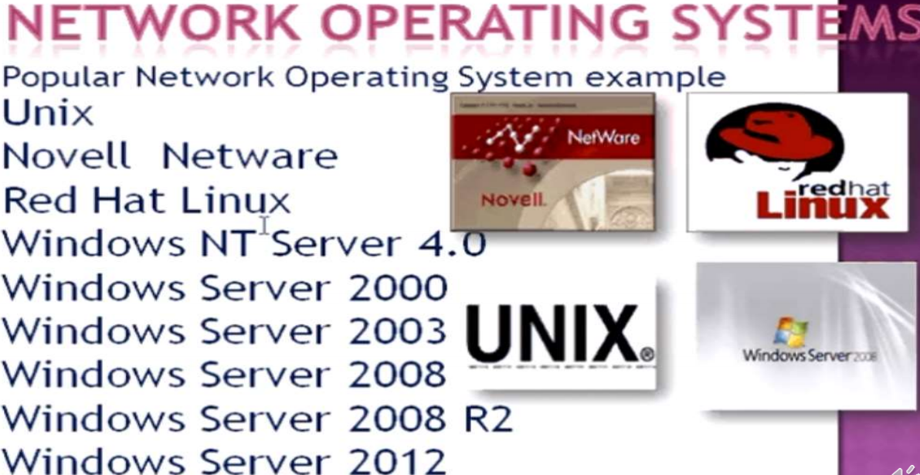

Slide 6
Chapter 1: Introduction
What Operating Systems Do
Operating-System Structure
Operating-System Operations
Process Management
Memory Management
Storage Management
Protection and Security
Special-Purpose Systems
(Chapter 1 Sections 1.1,1.4-1.11 of Text Book 1) (3 hrs)
1. A. Silberschatz, P. B. Galvin and G. Gagne, “Operating System Principles”, Eighth Edition, Wiley and Sons (Asia) Pte Ltd.2009.

Slide 7
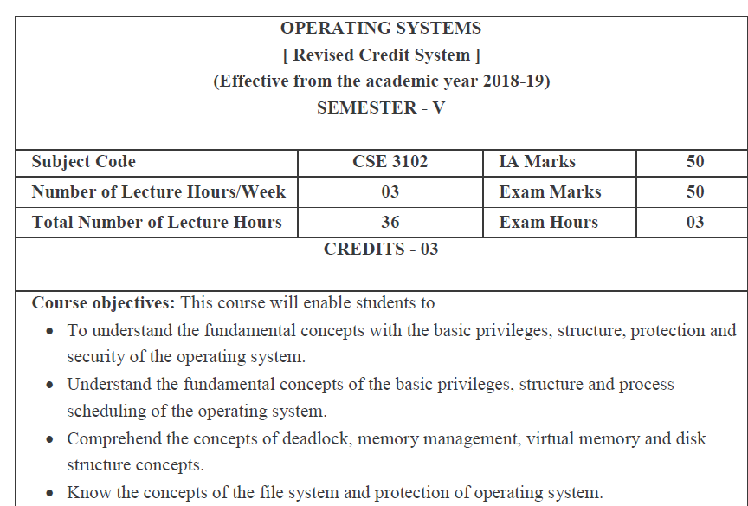

Slide 8
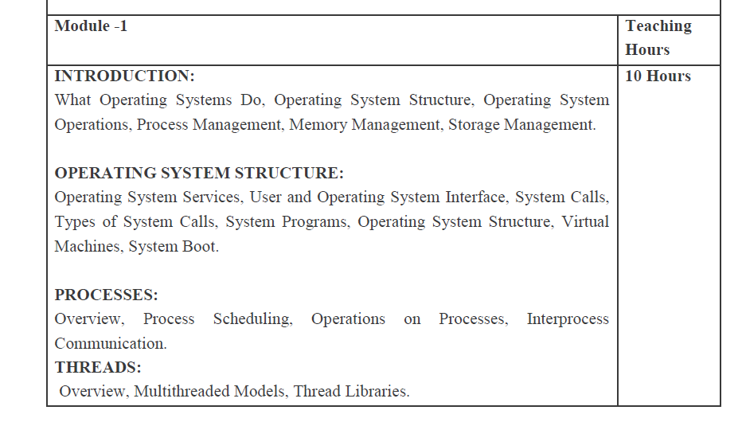

Slide 9
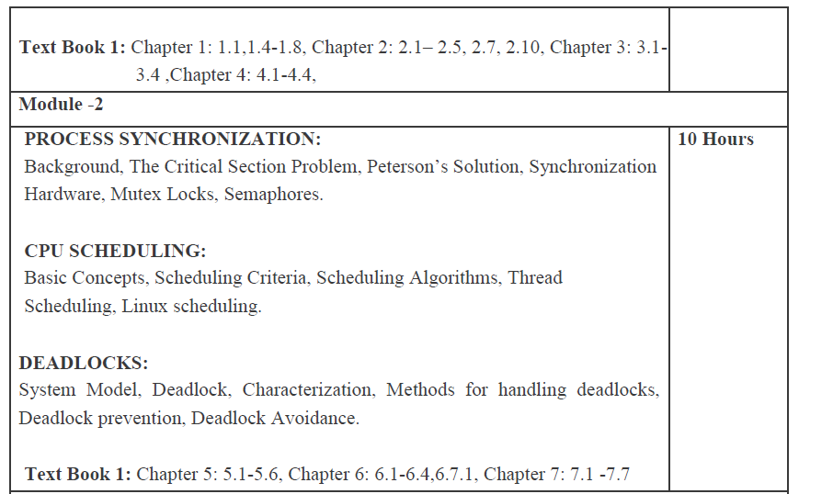

Slide 10
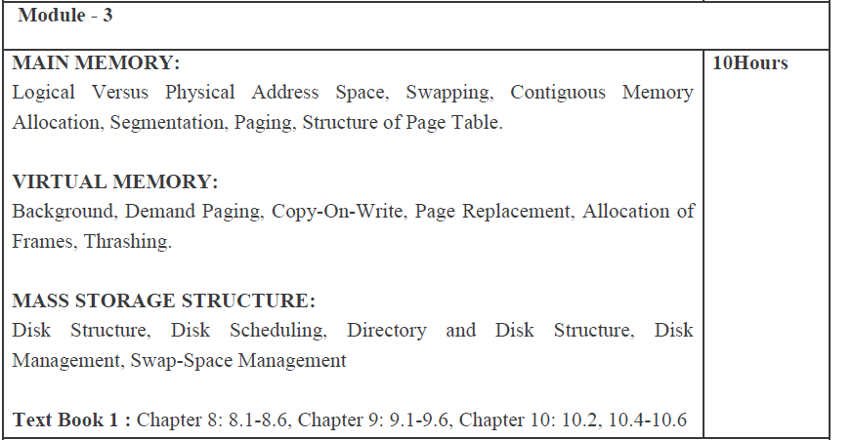

Slide 11
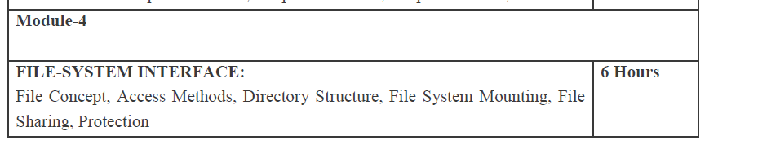

Slide 12
Objectives
To provide a grand tour of the major operating systems components
To provide coverage of basic computer system organization

Slide 13
SINGLE TASKING OR SERIAL PROCESSING
BATCH
MULTITASKING OR MULTIPROCESSOR
TIME SHARING
REAL TIME
DISTRIBUTED
NETWORKING

Slide 14
Operating System Definition (Cont.)
No universally accepted definition
“Everything a vendor ships when you order an operating system” is good approximation
But varies wildly
“The one program running at all times on the computer” is the kernel. Everything else is either a system program (ships with the operating system) or an application program.

Slide 15
What is an Operating System?
A program that acts as an intermediary between a user of a computer and the computer hardware
Operating system goals:
Execute user programs and make solving user problems easier
Make the computer system convenient to use
Use the computer hardware in an efficient manner

Slide 16
Computer System Structure
Computer system can be divided into four components:
Hardware – provides basic computing resources
CPU, memory, I/O devices
Operating system
Controls and coordinates use of hardware among various applications and users
Application programs – define the ways in which the system resources are used to solve the computing problems of the users
Word processors, compilers, web browsers, database systems, video games
Users
People, machines, other computers

Slide 17
An operating system is a program that manages the computer hardware
provides a basis for application programs
acts as an intermediary between computer-user and hardware
provides an environment within which other programs can do work
Objectives:
To provide a grand tour of the major components of operating system.
To describe the basic organization of the computer.

Slide 18
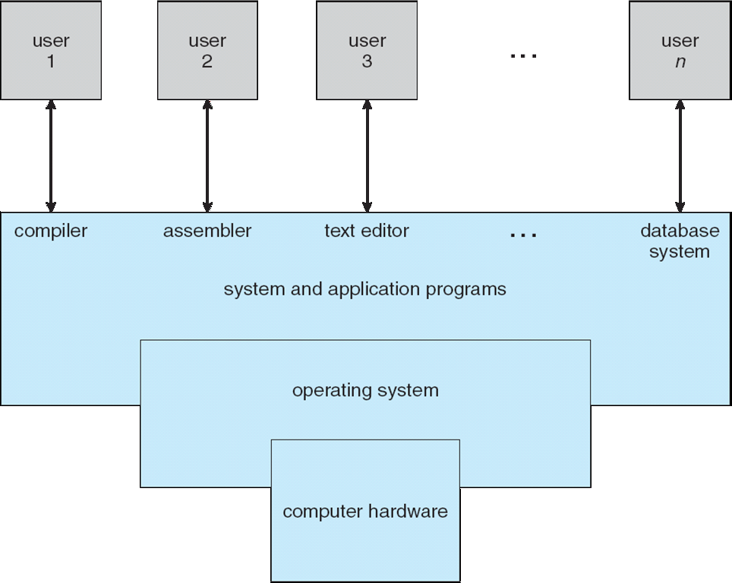
Four Components of a Computer System

Slide 19
What Operating Systems Do
Depends on the point of view
Users want convenience, ease of use
Don’t care about resource utilization
But shared computer such as mainframe or minicomputer must keep all users happy
Users of dedicate systems such as workstations have dedicated resources but frequently use shared resources from servers
Handheld computers are resource poor, optimized for usability and battery life
Some computers have little or no user interface, such as embedded computers in devices and automobiles

Slide 20
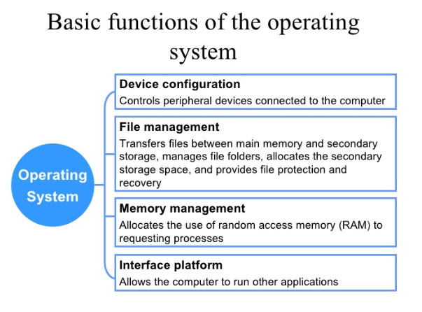

Slide 21
Operating System Definition
OS is a resource allocator
Manages all resources
Decides between conflicting requests for efficient and fair resource use
OS is a control program
Controls execution of programs to prevent errors and improper use of the computer

Slide 22
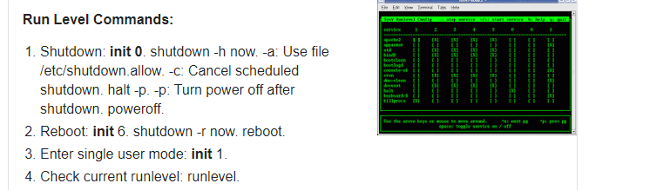
Computer Startup
bootstrap program is loaded at power-up or reboot
Typically stored in ROM or EPROM, generally known as firmware
Initializes all aspects of system
Loads operating system kernel and starts execution

Slide 23
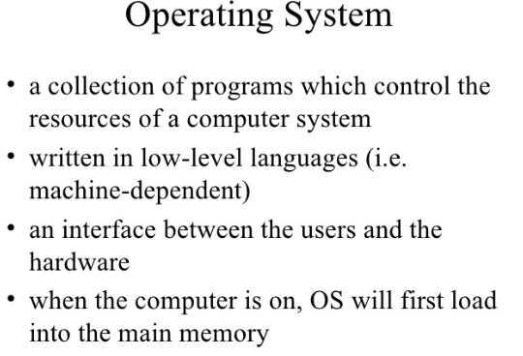

Slide 24
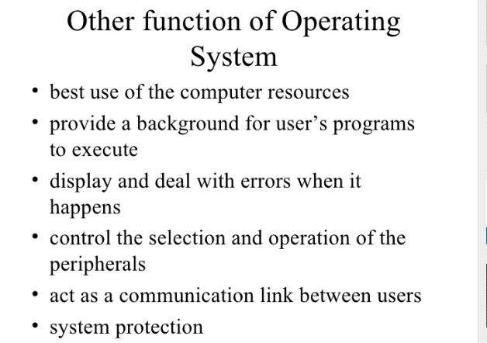

Slide 25
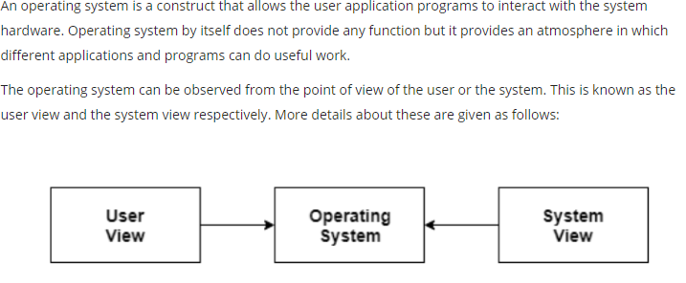

Slide 26
Operating System Structure
Multiprogramming needed for efficiency
Single user cannot keep CPU and I/O devices busy at all times
Multiprogramming organizes jobs (code and data) so CPU always has one to execute
A subset of total jobs in system is kept in memory
One job selected and run via job scheduling
When it has to wait (for I/O for example), OS switches to another job
Timesharing (multitasking) is logical extension in which CPU switches jobs so frequently that users can interact with each job while it is running, creating interactive computing
Response time should be < 1 second
Each user has at least one program executing in memory process
If several jobs ready to run at the same time  CPU scheduling
If processes don’t fit in memory, swapping moves them in and out to run
Virtual memory allows execution of processes not completely in memory

Slide 27
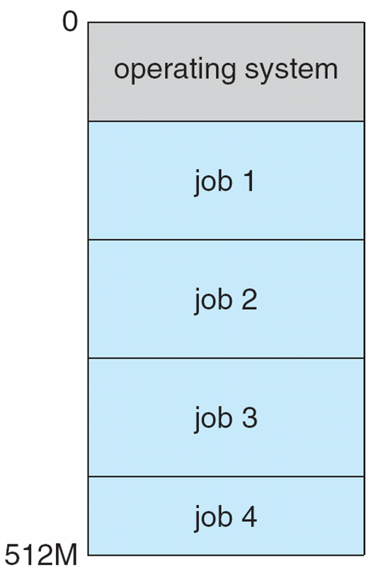
Memory Layout for Multiprogrammed System

Slide 28
Operating-System Operations
Interrupt driven by hardware
Software error or request creates exception or trap
Division by zero, request for operating system service
Other process problems include infinite loop, processes modifying each other or the operating system
Dual-mode operation allows OS to protect itself and other system components
User mode and kernel mode
Mode bit provided by hardware
Provides ability to distinguish when system is running user code or kernel code
Some instructions designated as privileged, only executable in kernel mode
System call changes mode to kernel, return from call resets it to user

Slide 29
1. Multi programming –
In a modern computing system, there are usually several concurrent application processes which want to execute.
Now it is the responsibility of the Operating System to manage all the processes effectively and efficiently.
One of the most important aspects of an Operating System is to multi program.
In a computer system, there are multiple processes waiting to be executed, i.e. they are waiting when the CPU will be allocated to them and they begin their execution.
These processes are also known as jobs. Now the main memory is too small to accommodate all of these processes or jobs into it.
Thus, these processes are initially kept in an area called job pool or Job queue. This job pool consists of all those processes awaiting allocation of main memory and CPU.
CPU selects one job out of all these waiting jobs, brings it from the job pool to main memory and starts executing it. The processor executes one job until it is interrupted by some external factor or it goes for an I/O task.

Slide 30
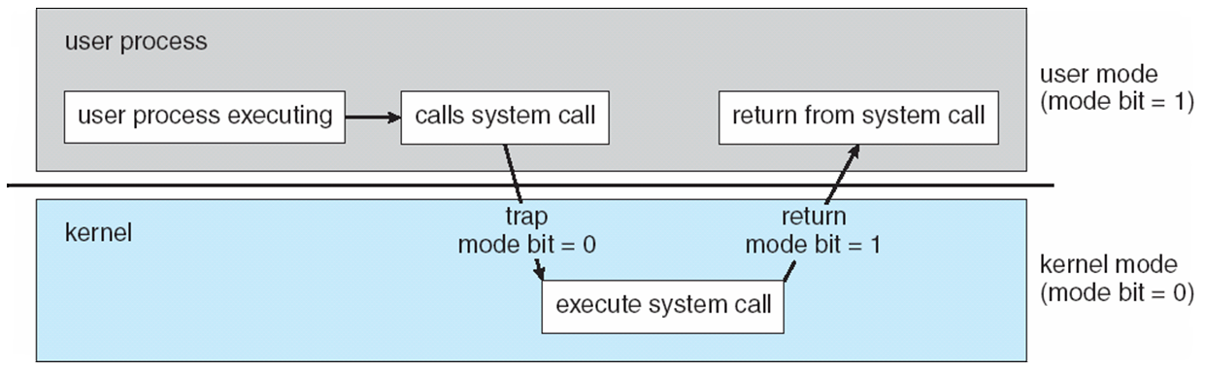
Transition from User to Kernel Mode
Timer to prevent infinite loop / process hogging resources
Set interrupt after specific period
Operating system decrements counter
When counter zero generate an interrupt
Set up before scheduling process to regain control or terminate program that exceeds allotted time

Slide 31
Dual Mode operations in OS
An error in one program can adversely effect many processes, it might modify data of another program, or also can effect the operating system.
For example, if a process stuck in infinite loop then this infinite loop could effect correct operation of other processes. So to ensure the proper execution of the operating system there are two modes of operation:
Notes:
Like handling exceptions like divide by zero , infinite loop etc

Slide 32
User mode – When the computer system run user application like creating a text document or using any application program, then the system is in user mode. When the user application requests for a service from the operating system or an interrupt occurs or system call, then there there will be a transition from user to kernel mode to fulfill the requests.
Note: To switch from kernel mode to user mode, mode bit should be 1.

Slide 33
Kernel Mode – When system boots then hardware starts in kernel mode and when operating system is loaded then it start user application in user mode.
To provide protection to the hardware, we have privileged instructions which execute only in kernel mode.
If user attempt to run privileged instruction in user mode then it will treat instruction as illegal and traps to OS.
Some of the privileged instructions are:
Handling Interrupts
To switch from user mode to kernel mode.
Input Output management.

Slide 34
Process Management
A process is a program in execution. It is a unit of work within the system. Program is a passive entity, process is an active entity.
Process needs resources to accomplish its task
CPU, memory, I/O, files
Initialization data
Process termination requires reclaim of any reusable resources
Single-threaded process has one program counter specifying location of next instruction to execute
Process executes instructions sequentially, one at a time, until completion
Multi-threaded process has one program counter per thread
Typically system has many processes, some user, some operating system running concurrently on one or more CPUs
Concurrency by multiplexing the CPUs among the processes / threads

Slide 35
SINGLE TASKING OR SERIAL PROCESSING In this type of Operating System the system can process only one application in one time. In this type of Operating System the other application will start only when the first application process was not completed. For example, if we are entering the data in a text file we can not bring or use the bring command to bring some other file. For example, MS-DOS is a single tasking Operating System. This single Tasking Operating System are better performance as compared to multi-tasking

Slide 36
BATCH OPERATING SYSTEM The users of a batch operating system do not interact with the computer directly. Each user prepares his job on an off-line device like punch cards and submits it to the computer operator. To speed up processing, jobs with similar needs are batched together and run as a group. The programmers leave their programs with the operator and the operator then sorts the programs with similar requirements into batches.

Slide 37
MULTITASKING OR MULTIPROCESSOR Multitasking, in an operating system, is allowing a user to perform more than one computer task (such as the operation of an application program) at a time.
The operating system is able to keep track of where you are in these tasks and go from one to the other without losing information.
For example, When you open your Web browser and then open Word at the same time, you are causing the operating system to do multitasking. Being able to do multitasking doesn't mean that an unlimited number of tasks can be juggled at the same time. Each task consumes system storage and other resources. As more tasks are started, the system may slow down or begin to run out of shared storage

Slide 38
TIME SHARING OPERATING SYSTEM Time-sharing is a technique which enables many people, located at various terminals, to use a particular computer system at the same time. Time-sharing or multitasking is a logical extension of multiprogramming. Processor's time which is shared among multiple users simultaneously is termed as time-sharing. The main difference between Multiprogrammed and Time-Sharing Systems is that in case of Multiprogrammed, the objective is to maximize processor use, whereas in Time-Sharing Systems, the objective is to minimize response time

Slide 39
REAL TIME OPERATING SYSTEM Real-time systems are used when there are rigid time requirements on the operation of a processor or the flow of data and real-time systems can be used as a control device in a dedicated application.
A real-time operating system must have well-defined, fixed time constraints, otherwise the system will fail. For example, Scientific experiments, medical imaging systems, industrial control systems, weapon systems, robots, air traffic control systems, etc.
There are two types of real-time operating systems.
1. Hard real-time systems
2. Soft real-time systems

Slide 40
Hard real-time systems:- Hard real-time systems guarantee that critical tasks complete on time. In hard real-time systems, secondary storage is limited or missing and the data is stored in ROM. In these systems, virtual memory is almost never found.
Soft real-time systems:- Soft real-time systems are less restrictive. A critical real-time task gets priority over other tasks and retains the priority until it completes. Soft real-time systems have limited utility than hard real-time systems. For example, multimedia, virtual reality, Advanced Scientific Projects like undersea exploration and planetary rovers,

Slide 41
NETWORKING OPERATING SYSTEM A Network Operating System runs on a server and provides the server the capability to manage data, users, groups, security, applications, and other networking functions.
The primary purpose of the network operating system is to allow shared file and printer access among multiple computers in a network, typically a local area network (LAN), a private network or to other networks.
Examples of network operating systems include Microsoft Windows Server 2003, Microsoft Windows Server 2008, UNIX, Linux, Mac OS X, Novell NetWare, and BSD.

Slide 42
Process Management Activities
The operating system is responsible for the following activities in connection with process management:
Creating and deleting both user and system processes
Suspending and resuming processes
Providing mechanisms for process synchronization
Providing mechanisms for process communication
Providing mechanisms for deadlock handling

Slide 43
Memory Management
All data in memory before and after processing
All instructions in memory in order to execute
Memory management determines what is in memory when
Optimizing CPU utilization and computer response to users
Memory management activities
Keeping track of which parts of memory are currently being used and by whom
Deciding which processes (or parts thereof) and data to move into and out of memory
Allocating and deallocating memory space as needed

Slide 44
Storage Management
OS provides uniform, logical view of information storage
Abstracts physical properties to logical storage unit - file
Each medium is controlled by device (i.e., disk drive, tape drive)
Varying properties include access speed, capacity, data-transfer rate, access method (sequential or random)
File-System management
Files usually organized into directories
Access control on most systems to determine who can access what
OS activities include
Creating and deleting files and directories
Primitives to manipulate files and dirs
Mapping files onto secondary storage
Backup files onto stable (non-volatile) storage media

Slide 45
Mass-Storage Management
Usually disks used to store data that does not fit in main memory or data that must be kept for a “long” period of time
Proper management is of central importance
Entire speed of computer operation hinges on disk subsystem and its algorithms
OS activities
Free-space management
Storage allocation
Disk scheduling
Some storage need not be fast
Tertiary storage includes optical storage, magnetic tape
Still must be managed – by OS or applications
Varies between WORM (write-once, read-many-times) and RW (read-write)

Slide 46
Protection, then, is any mechanism for controlling the access of processes or users-to the resources defined by a computer system. This mechanisms must provide means to specify the controls to be imposed and means to enforce the controls.
Protection can improve reliability by detecting latent errors at the interfaces between component subsystems.
Early detection of interface errors can often
prevent contamination of a healthy subsystem by another subsystem that is malfunctioning
A system can have adequate protection but still be prone to failure and allow inappropriate access.

Slide 47
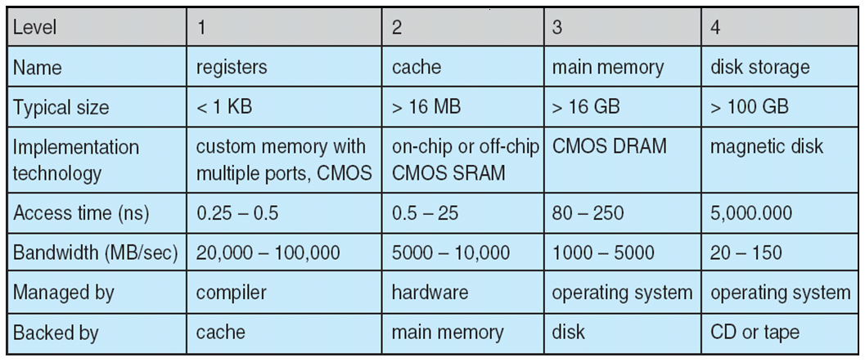
Performance of Various Levels of Storage
Movement between levels of storage hierarchy can be explicit or implicit

Slide 48
End of Chapter 1

